Slide 1
About GreeneStep New
Warehouse Automation App

Slide 2
Showcase
Warehouse Automation App (Using Barcode Scanner & Smart Tablet Device)
Standard App Features & Process
  Scan, Confirm, Receive and Stick the BarCode Labels
  Scan and Pick to Ship
  Scan and Generate Physical Stock Count File
Palletization Features & Process
  Build Pallets or Auto Palletize by Stacking Products. Generate and Stock Barcodes on Pallets
  Re-Palletizing and Capture Service Hours
  Pick and Ship by Pallets or Boxes from Pallets

Slide 3
WH Automation Benefits
Operate from Mobile Tablets with Bluetooth BarCode Scanner and Printers
Print BarCode Labels directly from the WH App
Error reduction & enhanced accuracy
Increased efficiency & speed
Real-time visibility & Improved order fulfillment
Overall cost savings
Notes:
Increased efficiency : Automation apps streamline various processes within the warehouse, such as inventory management, order fulfillment, and picking and packing. This results in faster and more accurate operations, reducing the time and effort required to handle tasks manually.
Enhanced accuracy: Manual data entry and handling can lead to errors, but automation apps minimize the risk of mistakes. This accuracy is especially crucial in inventory management, preventing stock outs or overselling.
Real-time visibility: Automation apps provide real-time visibility into inventory levels, order status, and overall warehouse performance. This visibility enables better decision-making and helps businesses respond quickly to changing demands.
BarCode Labelling : As businesses grow, the demands on their warehouse operations increase. Warehouse automation apps are designed to scale with the business, accommodating higher order volumes handling using scanners
Improved order fulfillment: Warehouse automation apps enable efficient order processing, picking, and packing, leading to faster order fulfillment and quicker deliveries to customers.
Inventory optimization: By tracking inventory levels and turnover in real-time, warehouse automation apps can help businesses optimize their stock levels, reducing carrying costs and minimizing the chances of overstocking or stockouts.
Error reduction: Automation reduces the chances of human error, leading to more accurate order processing, inventory management, and shipment tracking.
Labor cost savings: By automating repetitive tasks, businesses can reduce the reliance on manual labor, potentially leading to cost savings in the long run.

Slide 4
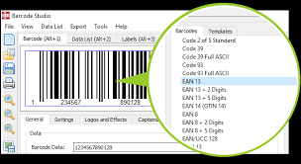
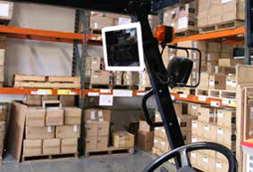
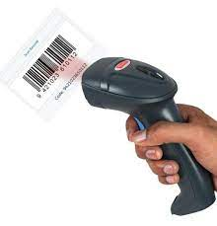
Demo App

Slide 5
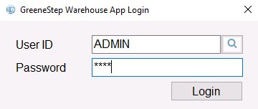
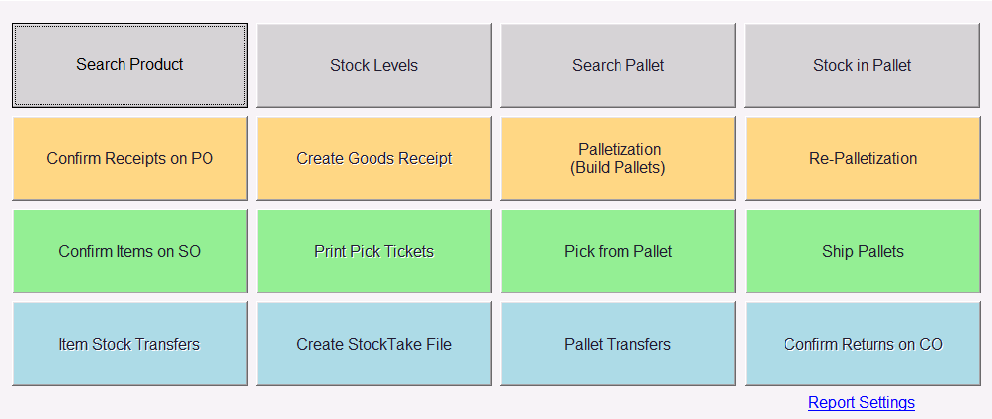

Slide 6
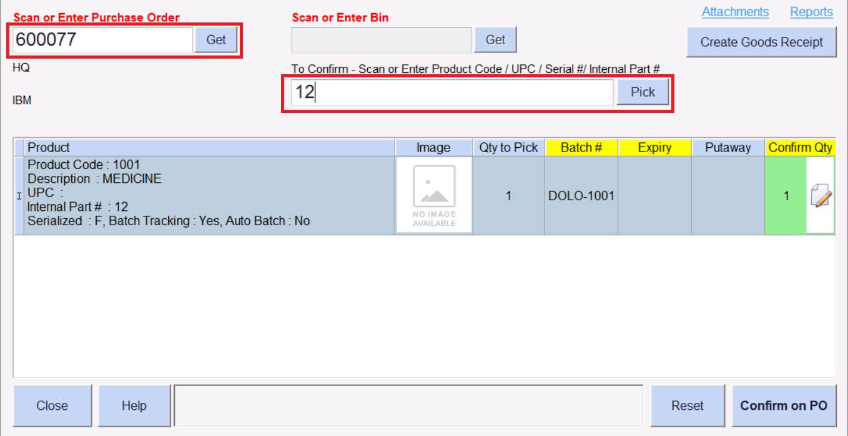
Scan & Confirm Receipt Qty on PO
Scan the PO # barcode using the scanner device.
Enter the PO number manually & Enter or Click Get
After the quantity is confirmed click “Confirm on PO”

Slide 7
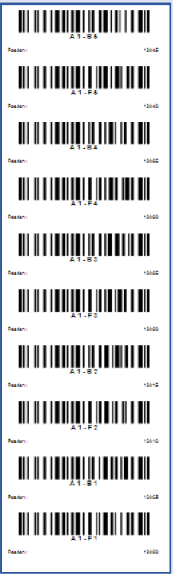
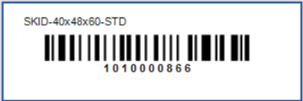
Barcode Labels and GR Confirmation Reports
Scan the PO # barcode using the scanner device or Enter PO#
Go to Reports and Select Bar Code Label Report to Print Labels

Slide 8
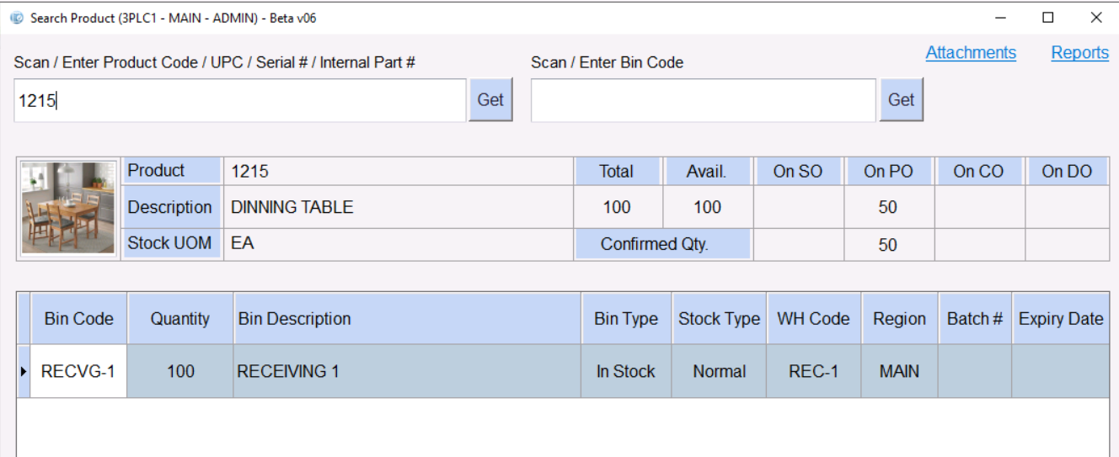
Scan and Search easily on the App
Scan Product SKU Code
Scan or Enter even UPC, Serial #, or internal part number

Slide 9
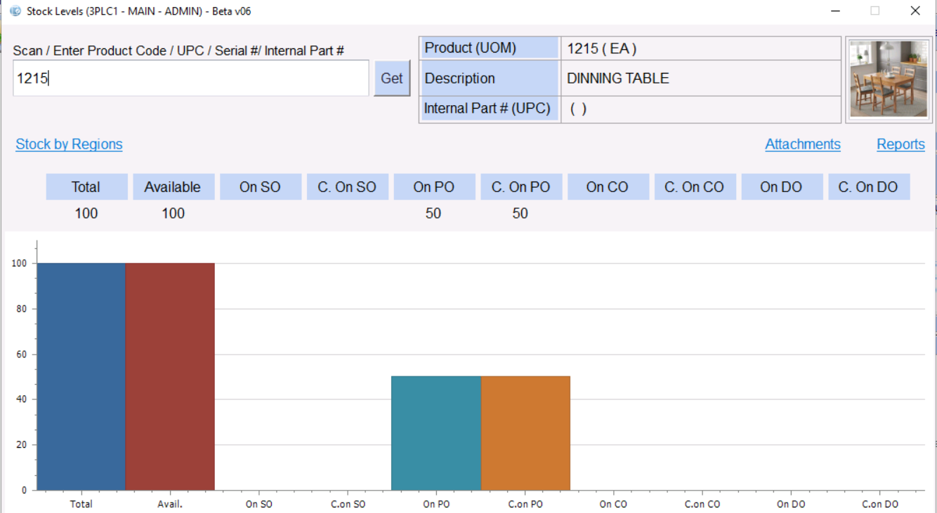
Scan Code and View Stock Levels

Slide 10
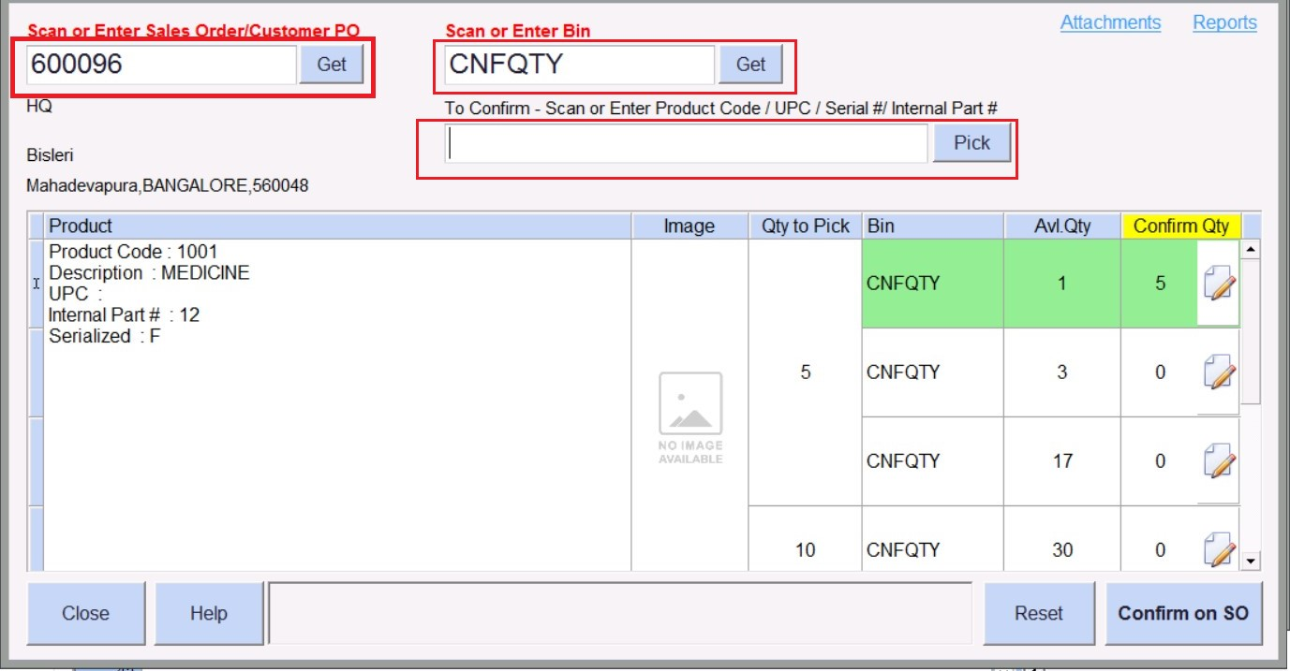
Scan to Confirm and Ship Items on SO
Scan or enter the SO number
Scan or enter bin code to choose
Confirmed Qty

Slide 11
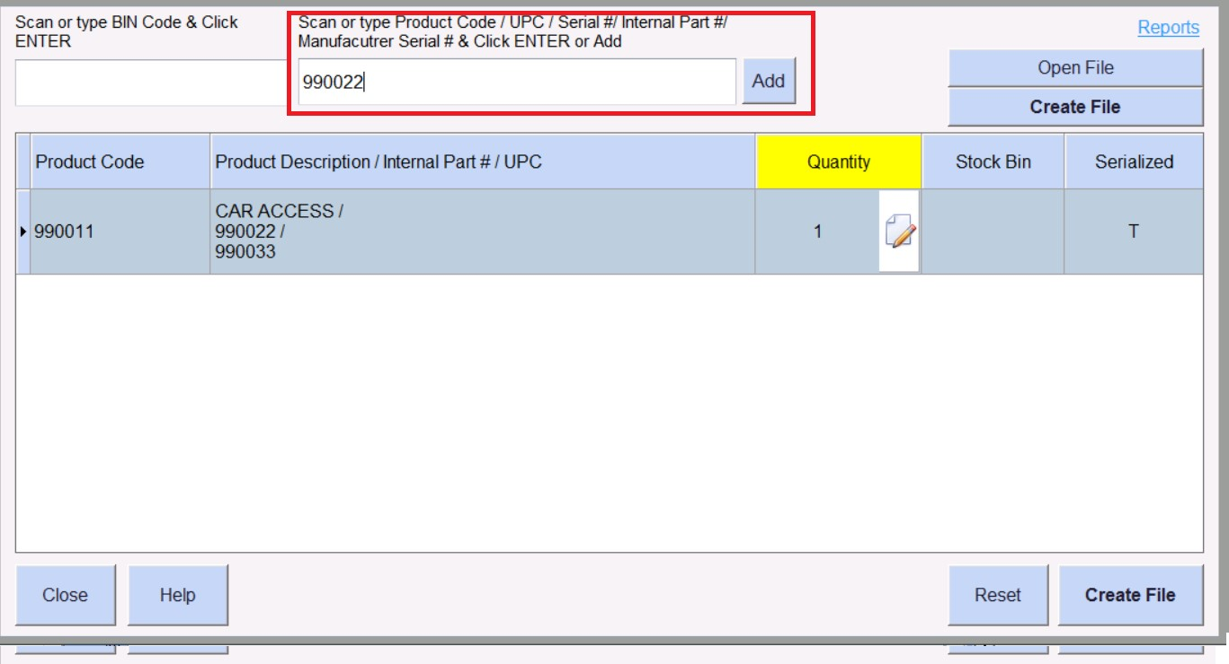
Scan and Create Stock Count File
Scan or enter bincode
Scan Product and Repeat
Click “Create File”

Slide 12
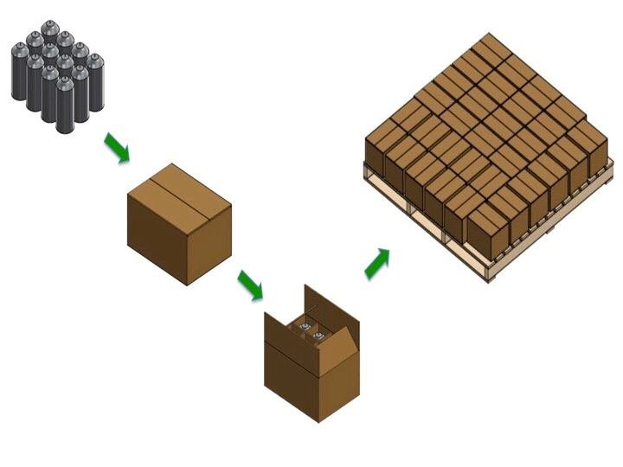
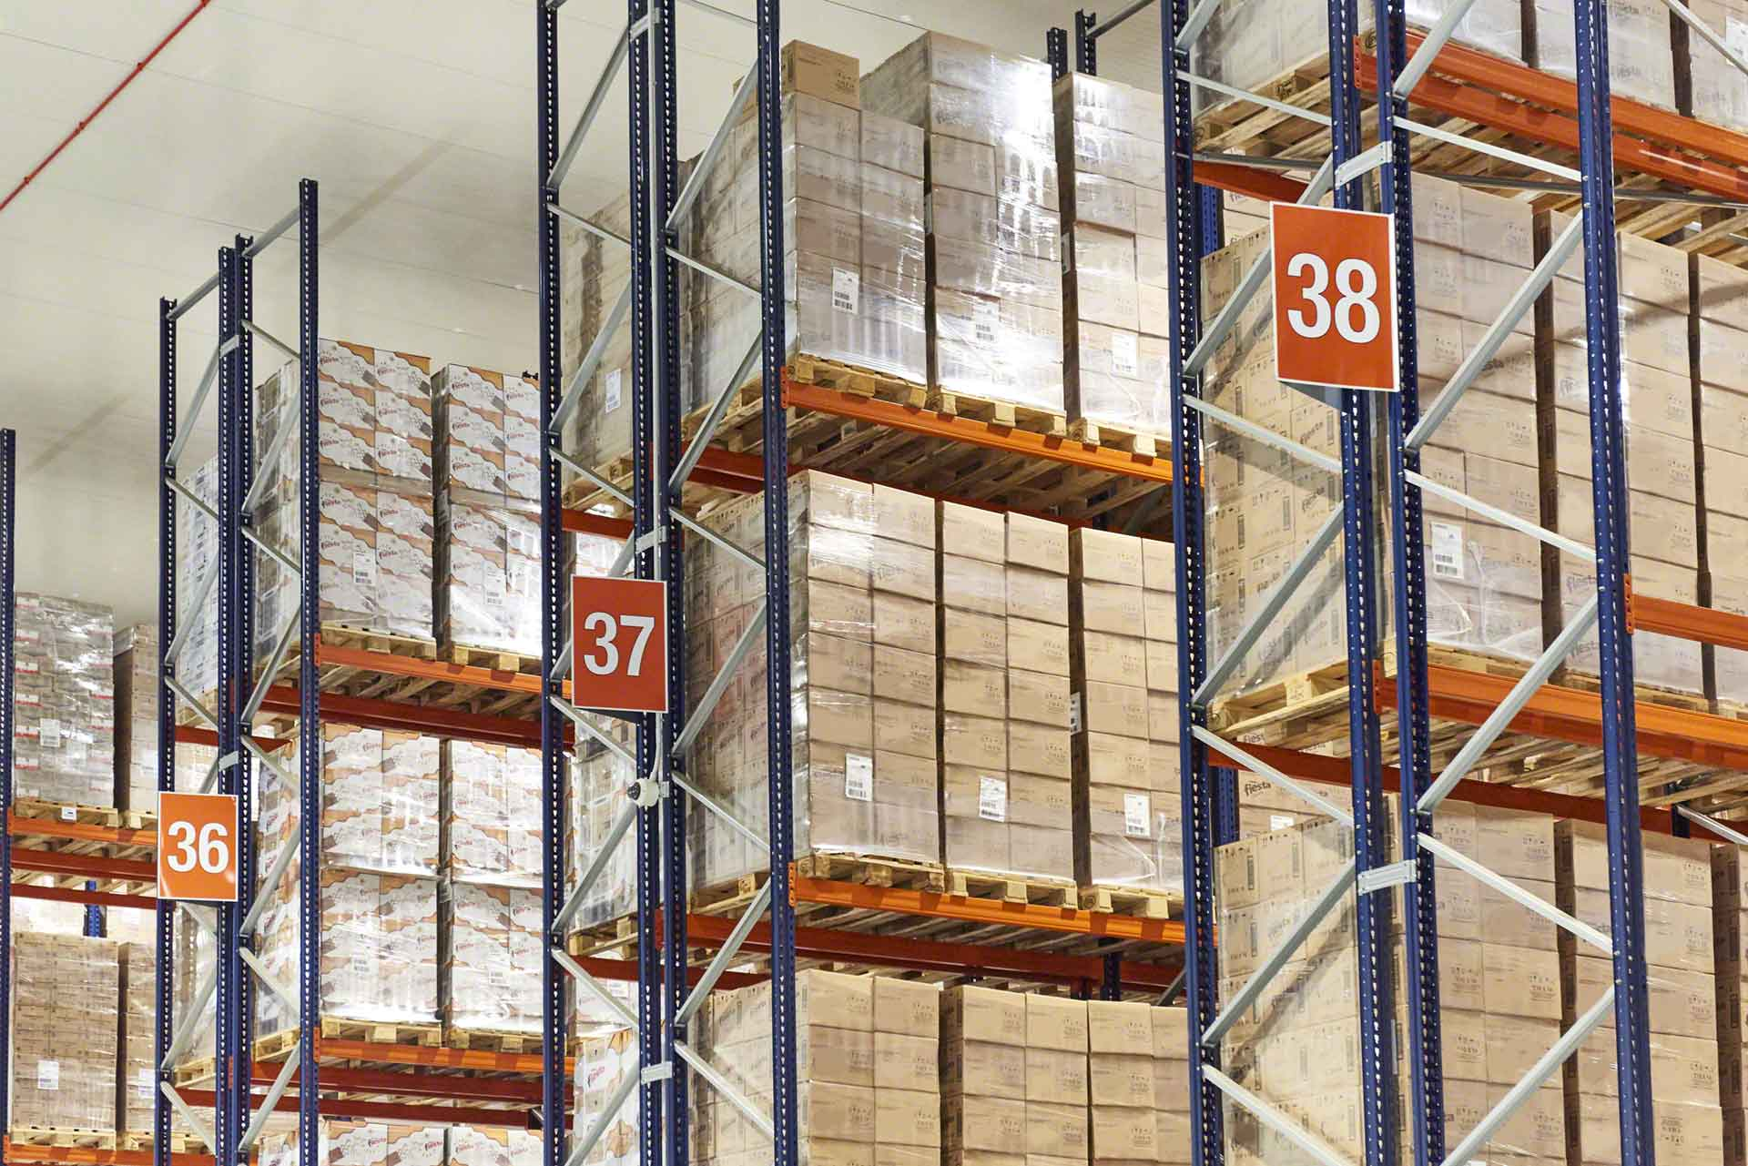
PALLETIZATION

Slide 13
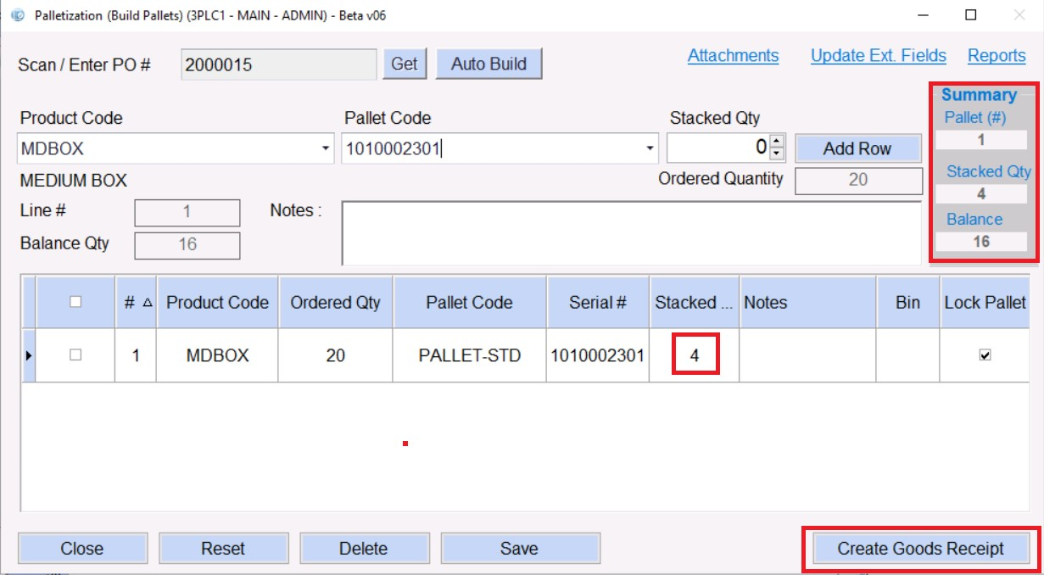
Auto Build Pallets
Scan or enter PO & Select product code
Click on Auto build or scan pallet code to stack qty
Click on create Goods receipt to Confirm the inwards

Slide 14
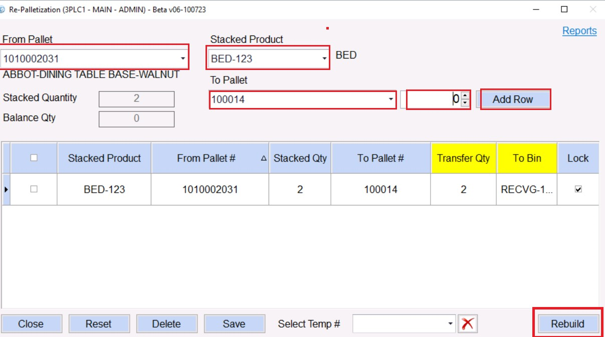
Rebuild Pallets Easily
Select the FROM Pallet # & Select the Product
Select TO Pallet & Select Qty and Click on Add row.
Click on Rebuild option button

Slide 15
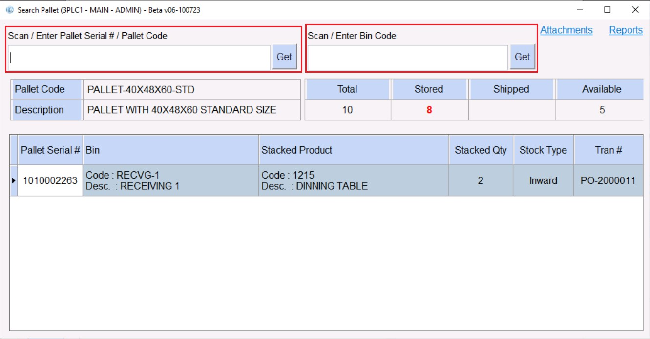
Scan and Search Pallets for Stacked Product Info

Slide 16
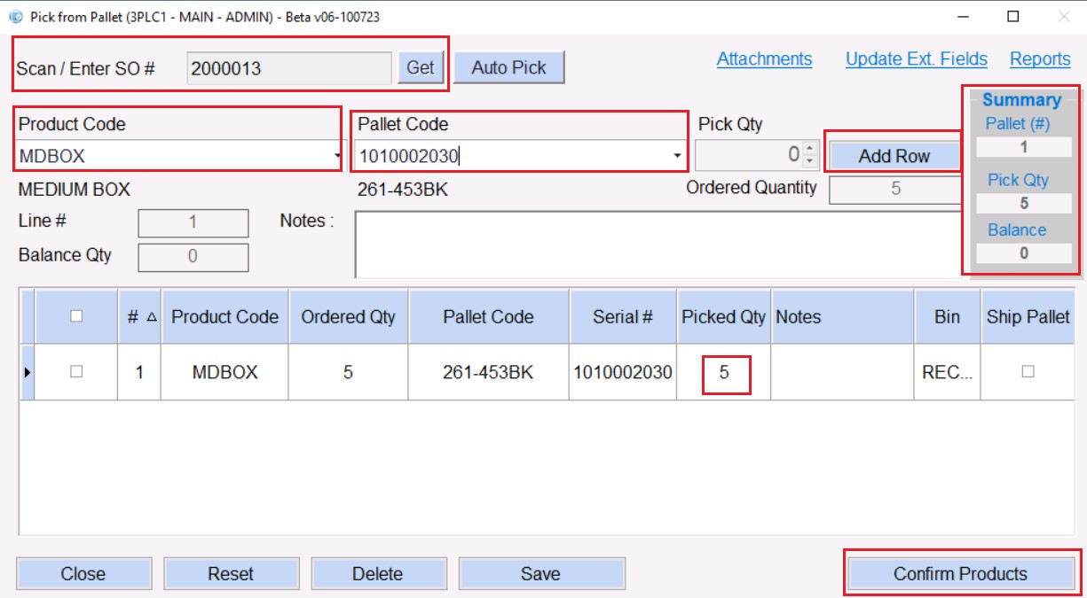
Pick and Ship from Pallet
Scan or enter SO.
Scan product code
Select pallet code
Pick quantity and add row
Click on confirm products

Slide 17
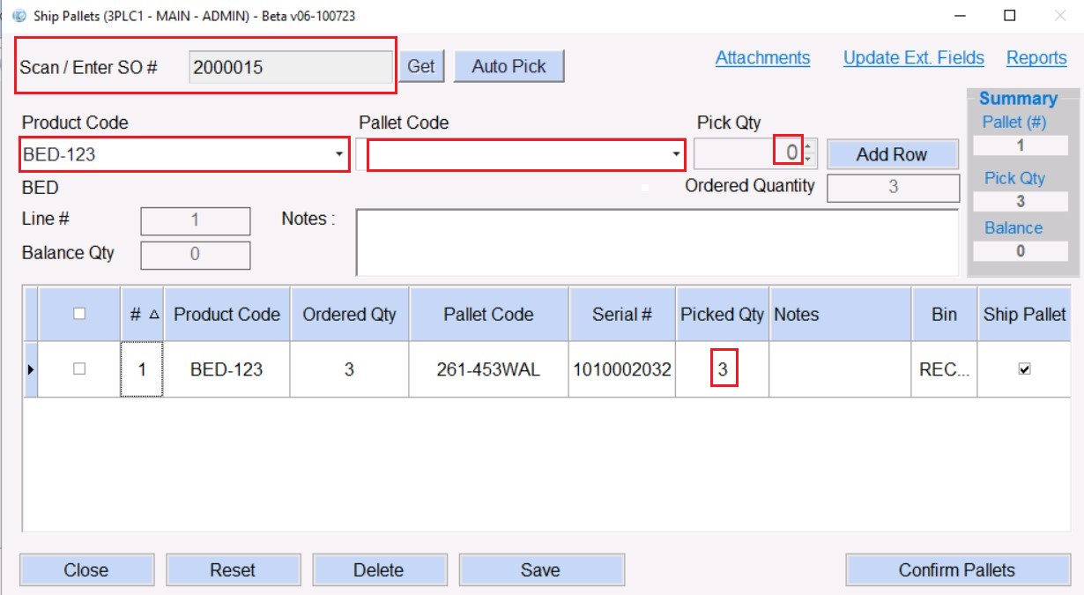
Ship by Pallets
Scan or enter SO #
Scan Pallet# to SHIP
Click on Confirm Pallets

Slide 18
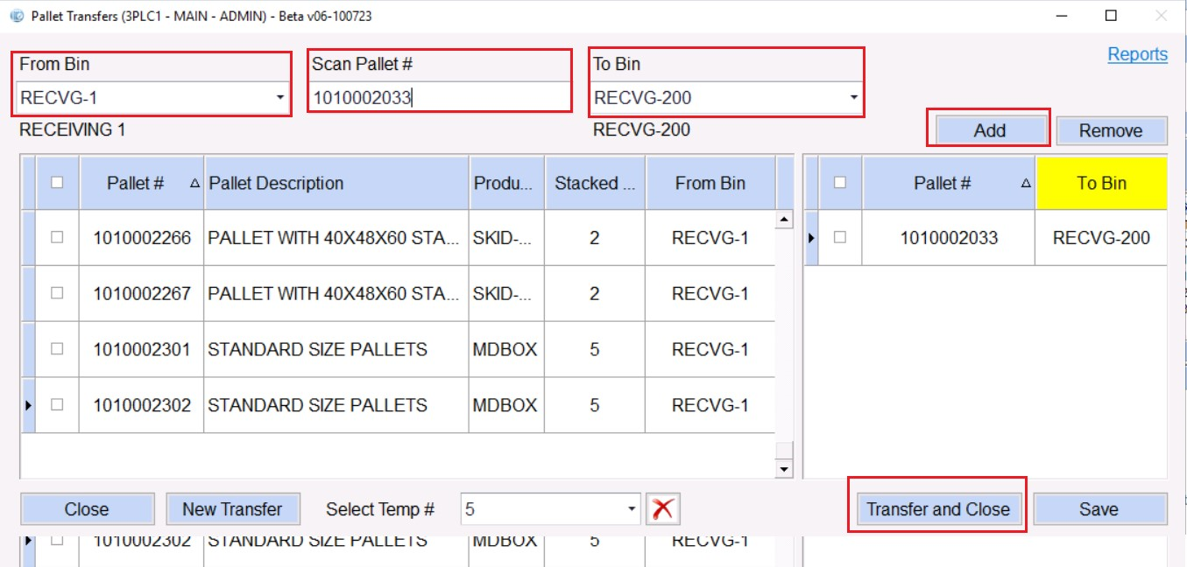
Transfer Pallets
Select the Bin & Scan pallet #.
Select To Bin to transfer
Click on add to confirm
Click on transfer and close button

Slide 19
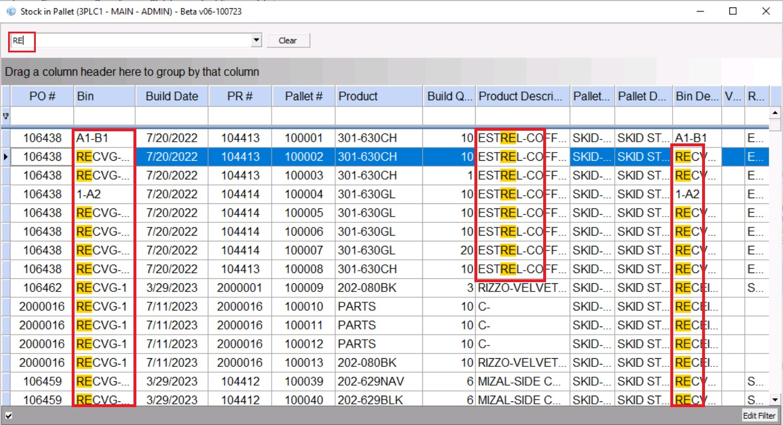
View Stocks in Pallet

Slide 20
Thank you
Email : Info@GreeneStep.com

